Slide 2
Chiropractic- Section 9

Slide 3
Objectives
Understanding Chiropractic Section-9
Clinical examples for better understanding
Knowledge Check
Exercises

Slide 4
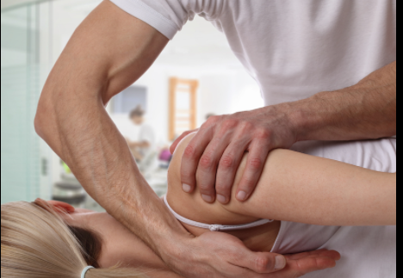
Chiropractic
The Chiropractic section consists of a single body system, Anatomical Regions, and a single root operation, Manipulation.
B – Manipulation is defined as manual procedure that involves a directed thrust to move a joint past the physiological range of motion, without exceeding the anatomical limit.

Slide 5
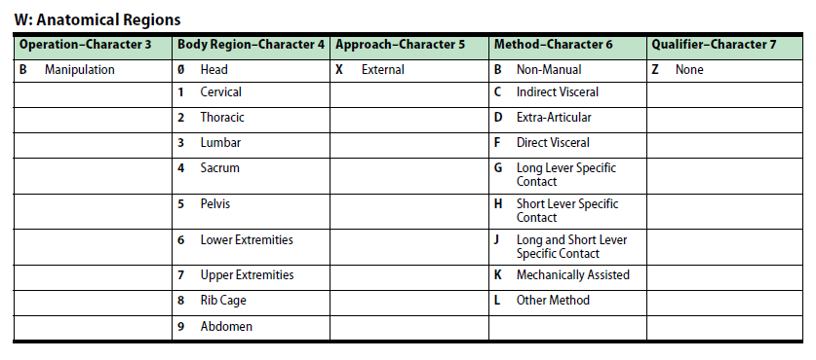
Chiropractic 9WB
Character Meanings

Slide 6
Chiropractic
Examples of Chiropractic include:
Chiropractic treatment of cervical spine, short lever specific contact
Non-manual chiropractic manipulation of pelvis
Chiropractic treatment of lumbar region using long lever specific contact

Slide 7
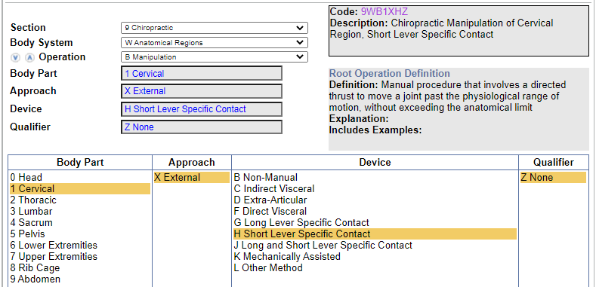
Clinical Example 1
Chiropractic treatment of cervical spine, short lever specific contact
Code: 9WB1XHZ (Chiropractic Manipulation of Cervical Region, Short Lever Specific Contact)
Coding Navigation:

Slide 8
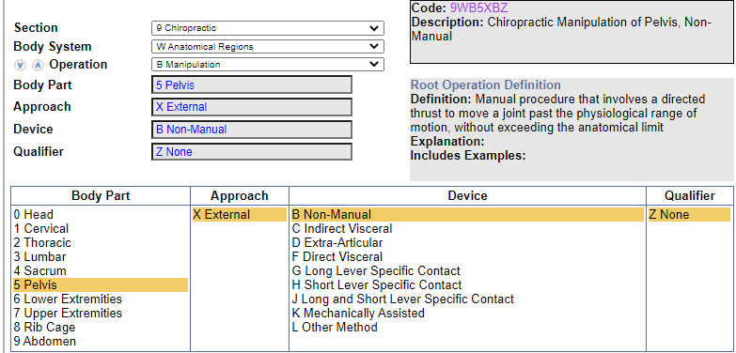
Clinical Example 2
Non-manual chiropractic manipulation of pelvis
Code: 9WB5XBZ (Chiropractic Manipulation of Pelvis, Non-Manual)
Coding Navigation:

Slide 9
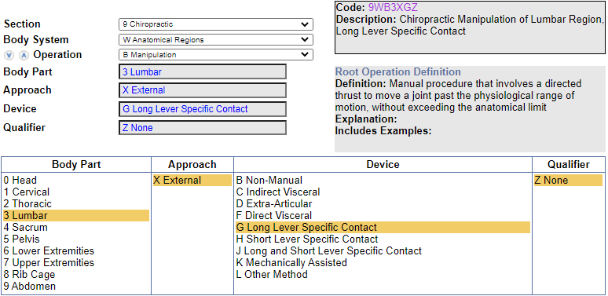
Knowledge Check 1
What is the code assignment for Chiropractic treatment of lumbar region using long lever specific contact?
Codes: 9WB3XGZ (Chiropractic Manipulation of Lumbar Region, Long Lever Specific Contact)
Code Navigation:

Slide 10
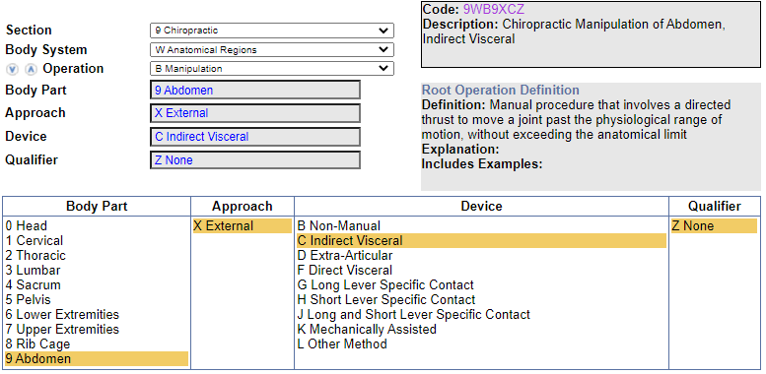
Knowledge Check 2
What is the code assignment for Chiropractic manipulation of abdominal region, indirect visceral?
Code: 9WB9XCZ (Chiropractic Manipulation of Abdomen, Indirect Visceral)
Code Navigation:

Slide 11
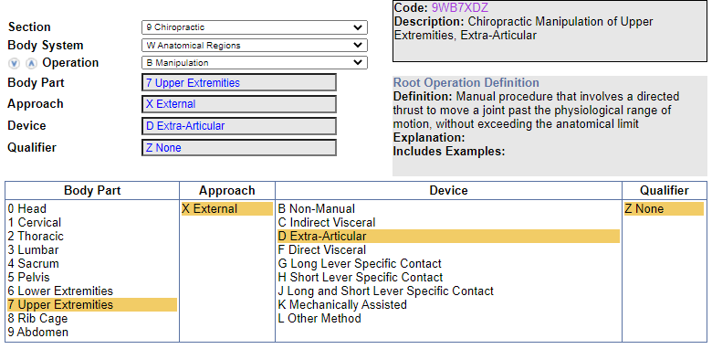
Exercise 1
What is the code assignment for Chiropractic extra-articular treatment of hip region?
Code: 9WB6XDZ (Chiropractic Manipulation of Upper Extremities, Extra-Articular)
Code Navigation:

Slide 12
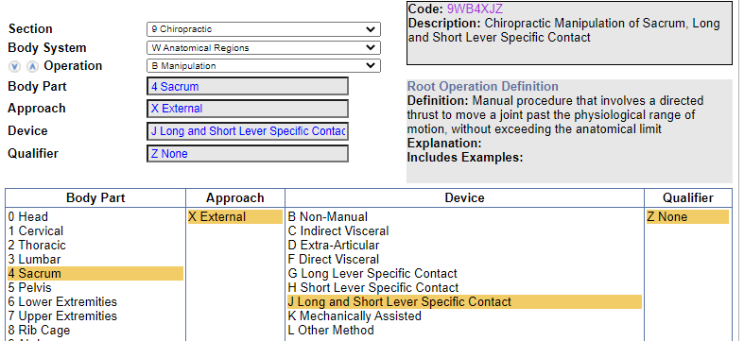
Exercise 2
What is the code assignment for Chiropractic treatment of sacrum using long and short lever specific contact?
Code: 9WB4XJZ (Chiropractic Manipulation of Sacrum, Long and Short Lever Specific Contact)
Code Navigation:

Slide 13
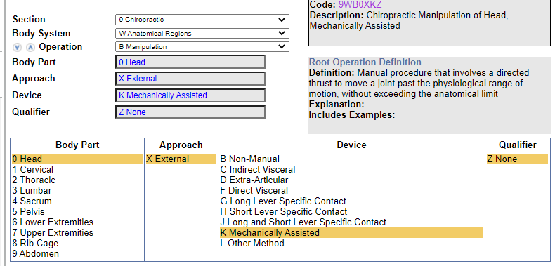
Exercise 3
What is the code assignment for Mechanically-assisted chiropractic manipulation of head?
Code: 9WB0XKZ (Chiropractic Manipulation of Head, Mechanically Assisted)
Code Navigation:

Slide 14
Thank You

